Slide 1


Vibe Coding:
For AI-Driven Development
An Introduction for Research and
Learning
Ray Uzwyshyn Ph.D. MBA MLIS
Acting AUL and Director,
Research and Technology Services
University of California Riverside
University of California Riverside
Orbach Library AI Literacy Series
11/12/2025

Slide 2








AI & Vibe Coding Intro
Development Methodology
Part II: Workshop Component
Customizable Applications
Working With Advanced Tools

Slide 3

01
A Few Definitions
02
Environmental Scan

Slide 4

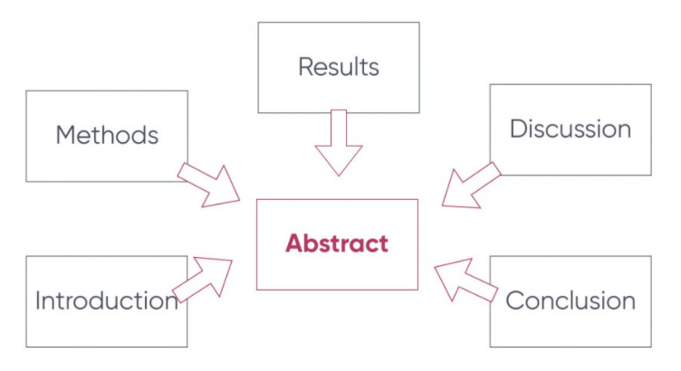
What is Vibe Coding?
Programming with AI Large Language Models, enabling Natural Language Coding through probabilistic/stochastic methods, contrasting with traditional deterministic programming.
Sometimes Called No or Low Code Programming
Or AI-Assisted Development

Slide 5
AI- Assisted Development:
Lowering Barriers, Accelerating Innovation
Rapid Prototyping
Accelerated Cycles
Versioning
Leverage AI for debugging, optimization, and feature implementation for
Research and Learning
Iterate quickly and iterate often
For Startups or Software Development.
Create applications through conversational interfaces.
Apps, Data Visualization
Not Massive Operating Systems
1000-3000 lines of code

Slide 6





AI Development Benefits
Rapid Prototyping
Innovation Cycles
AI-assisted development accelerates the creation of initial prototypes by allowing developers to describe desired outcomes in natural language, reducing the time needed for coding.
The iterative nature of AI development enables faster innovation cycles, allowing teams to quickly test and refine their applications based on real-time feedback.
Lowering Barriers
Natural Language Support
Vibe coding lowers the technical barriers to entry, making it easier for non-technical users to create functional applications without extensive programming knowledge.
AI models can support multiple programming or human languages, enabling developers to work in their preferred language while leveraging AI for debugging, optimization, and feature implementation.

Slide 7
Available in All Best-in-Class Reasoning Models
Proprietary
Open Source
Anthropic: Claude Sonnet 4.5, Opus 4.0
Meta: Llama 4 Series (2T, 400B)
OpenAI: GPT 5.1, o1/o3 pro, o4 mini-high
Alibaba: Qwen3 Model Family (72B)
Google: Gemini 2.5 Pro (2M Context)
DeepSeek: R1 (768B), R2 (Coming Soon)
xAI: Grok Code Fast 4
Mistral: Codestral
Kimi K2: Thinking Model

Slide 8

CHAPTER.02
Development Methodology

Slide 9
The AI-Enhanced Development Workflow
1. Define Goals
2. Plan Steps
3. AI Research
4. Web Search
Start with a clear project statement.
Create a step-by-step project plan.
Use AI for deep research and analysis.
Ensure currency with web searches.

Slide 10


AI Development Workflow
Project Goals
Step-by-Step Planning
AI-Enhanced Research
Start with a clear statement of project goals to provide a focused direction. This helps in aligning the AI's capabilities with the desired outcomes.
Follow a step-by-step project management plan to break down the development process into an iterative buildout process manageable tasks, ensuring systematic progress.
Utilize AI's extended thinking capabilities for research, data and deep analysis, and web searches to gather and verify the latest information and insights.

Slide 11
What is the Iterative Development Buildout Process?
Follow a Prompt-Test-Run-Repeat cycle.
(The Vibe)
Begin simply,
Build step by step
Maintain flexibility with probabilistic outputs.
REPEAT
Triple-check for AI hallucinations and errors.
Focus on lowering barriers for prototyping.
Use your creative research superpowers and human intuition.

Slide 12
Iterative Development Process – Major Pillars
Prompt-Test-Run-Repeat
Error Checking
Adopt a prompt-test-run-repeat cycle to iteratively refine the application. This approach ensures continuous improvement and adaptation.
Triple-check for AI hallucinations and errors to ensure the reliability of the generated code. Maintain flexibility with probabilistic outputs.

Slide 13
AI models can hallucinate. Human validation is crucial.
The Balance of Work Changes to:
Source Verification, Critique, Debugging and Source Evaluation
Cross-reference against other models & library sources.
Always Verify
Validate with reliable internet resources and primary sources.
Ensure accuracy and reliability through human judgment, intuition, critique and discrimination.

Slide 14
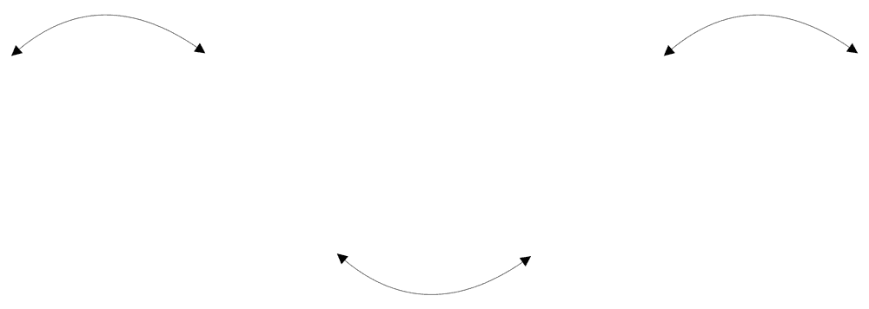




Source Verification, Evaluation, Critique, Discrimination
Reliable Sources
Cross-Referencing
Always verify AI-generated information through reliable sources such as academic databases, industry reports, and credible websites.
Cross-reference information against other AI models, internet resources, and library databases to ensure accuracy and reliability.
Human Validation
Avoiding Hallucinations
Human validation is crucial to confirm the factual correctness of AI-generated outputs, as AI models can sometimes produce probabilistically likely but factually incorrect information.
Be aware of AI hallucinations, which are outputs that seem plausible but are not based on factual data. This requires careful scrutiny and verification.

Slide 15
CHAPTER.03
Practical Applications

Slide 16
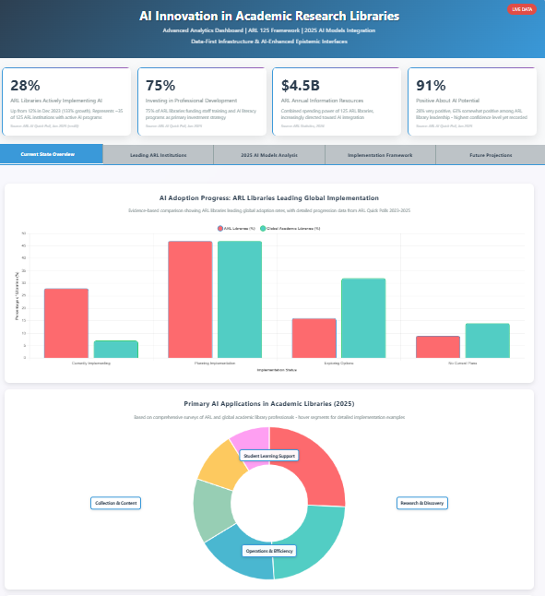
Data-Driven Dashboards
AI excels at creating interactive visualizations and analytics apps. Be specific in your prompts.
Specify colors, fonts, and styles.
Define sections and dropdown menus.
Start with a summary, then break it down.
https://claude.ai/public/artifacts/a9a18eba-a60e-44ac-9fbd-b5d4c2229bba

Slide 17




AI as a Multimodal Research Powerhouse
+
+
=
Research Papers
Excel Data
Video Content
Insights & Visuals
AI models can synthesize information from diverse sources to create comprehensive analyses and visualizations.

Slide 18
Multimodal AI Models : Beyond Text
Advanced models like GPT-4o, Sonnet 4.5, and Gemini 2.5 Pro handle diverse inputs and outputs.
Text + Image
Text + Data
Text + Video
Art analysis, architectural speculation.
Summarize trends from charts.
Summarize lectures, create study guides.

Slide 19
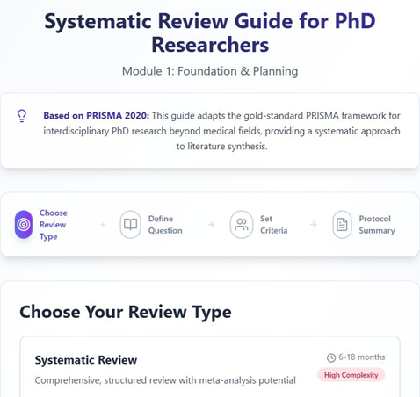
AI can structure and accelerate the creation of comprehensive research reviews by helping to organize, analyze, and synthesize vast amounts of literature.
Systematic Review & Synthesis
Develop systematic review frameworks.
Structure literature for meta-analyses.
Create research synthesis across disciplines.
Prisma Checklist: https://claude.ai/public/artifacts/c27167a0-49a1-4464-8e33-9b3e78041956
https://claude.ai/public/artifacts/3d20e402-7aaa-46d2-8723-7715438e6278

Slide 20

CHAPTER.04
Vibe Coded Apps
The AI API

Slide 21
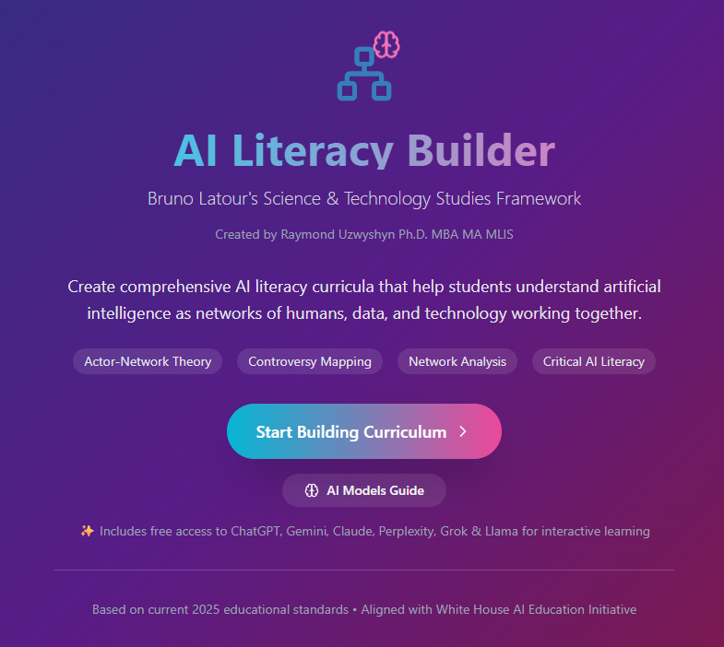
AI Literacy Builder
Anthropic AI API
Inspired by
Bruno Latour’s
Science Technology Society Framework
https://claude.ai/public/artifacts/da408442-9c2a-40d2-812e-39b8300f39c6

Slide 22
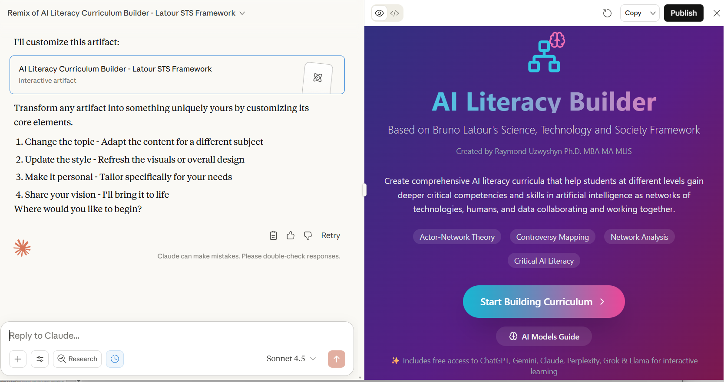


Slide 23
Building AI Literacy: Multiple Critical Lenses
Understanding AI's social, political, and cultural contexts beyond technical implementation.
Bruno Latour
Katherine Hayles
Donna Haraway
Actor-Network Theory: AI as socio-technical networks.
Posthuman Theory: AI challenging human consciousness.
Cyborg Theory: Examining AI through a feminist lens.

Slide 24
Incorporating Critical Perspectives
Ruha Benjamin
Langdon Winner
Safiya Noble
Race & Tech: How AI perpetuates or challenges inequalities.
Politics of Tech: AI systems embodying political values.
Algorithmic Bias: Critical analysis of discrimination in information systems.

Slide 25

Educational Applications
AI literacy curricula empower educators and prepare students for an AI-integrated future.
Empowers educators with new millennia AI curricula.
Helps students understand AI's societal context.
Aligns with White House AI plans and European mandates.

Slide 26
CHAPTER.05
AI LLMs Can Also Be Connected to Advanced Tools

Slide 27
AI Code Editors: A Spectrum of Power
Claude Code
Most Complex
Cursor / Replit
Advanced
Windsurf
Intermediate
Loveable
Simplest
These tools integrate with models like Sonnet 4.5 GPT-5, Grok 3, Gemini, and Qwen 3.

Slide 28
CHAPTER.07
Future Directions
Metaphors for Human
Ai Collaboration

Slide 29
The Topology of Collective Intelligence
New models for human-AI interaction are emerging, described by metaphors that capture different integration levels.
Cyborgs
Centaurs
Mermaids
Maenads
Wharton Business Professor Ethan Mollick uses Centaurs, Cyborgs, Mermaids and Maenads to describe human AI Co-Intelligence, Karen Barad’s uses Bohr’s quantum physic analogy and entanglement theory to
describes agency emerging from human-AI intra-action.

Slide 30

The Future is Entangled Co-Intelligence
The focus is shifting from AI replacement to AI partnership, creating collaborative intelligence that surpasses what either humans or AI can achieve alone.
This involves entangled partnerships where human creativity and intuition are amplified by AI's speed and scale.

Slide 31



Part II Workshop Component and Examples Vibe Coding For Research and Learning
Ray Uzwyshyn, Ph.D. MBA MLIS
Acting AUL for Research & Technology Services
Director of Research
UC Riverside Libraries, raymondu@ucr.edu
https://rayuzwyshyn.net https://www.linkedin.com/in/rayuzwyshyn/

Slide 32

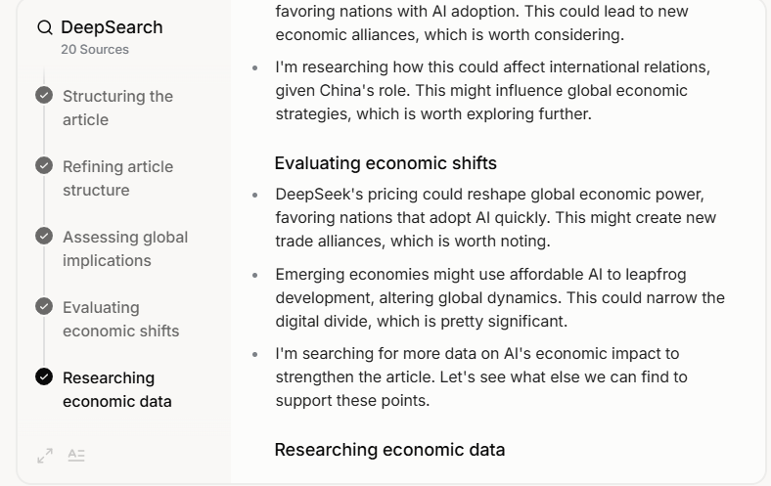
2025 Best in Class Reasoning Models
(Trial For Free)
AI AGI Research, Reasoning & Deep Research LLM’s Proprietary Anthropic Claude Sonnet 4.5 Opus 4.0 , Try Open AI Chat GPT 5.1 (Current flagship Combined Multimodal Model Family), Try GPT o1/o3 pro o4 mini-high Try Grok Code Fast 4, Try Gemini 2.5 Pro (Deep Think, Multimodal/video image) 2M Context Window Try | Research, Reasoning & Deep Research LLM’s (2025) (STEM Disciplines, Science Technology Engineering Math, Coding) Proprietary GPT o1/o3 pro o4 mini-high Try Claude Sonnet Opus Model Family, Try Grok 4, Try Gemini 2.5 Pro (Deep Think) 2M Context Window Try
Open Source Llama 4 Series (2T, 400B, 109B, 72B) Qwen3 Model Family (Alibaba, 72B) Mistral Codestral | Open Source DeepSeek R1 (768 Billion Parameters), Try, Perplexity, US R1-1776 Uncensored Version Kimi K2 Thinking Co-Scientist (Google, Beta) Co-Evolve (Deep Mind)

Slide 33
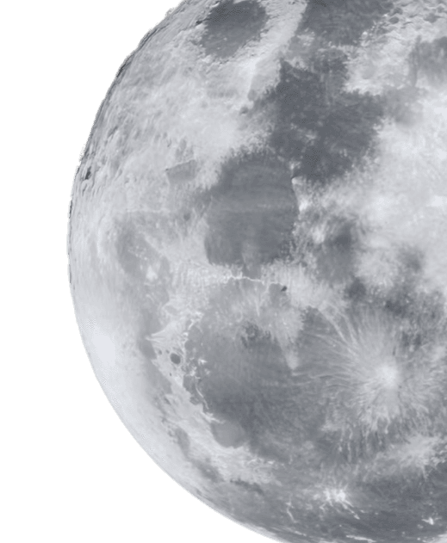
One Small Step

Slide 34

Implementation Roadmap
Getting Started
Begin with a free https://claude.ai signup, review provided links, and use customize buttons for data upload or research requests.
Educational Use
Focus on educational and non-commercial use, and contact raymondu@ucr.edu for notable projects and further guidance.

Slide 35
Your Roadmap to Implementation
1
2
3
4
Sign Up
Explore
Customize
Share
Start with a free Claude.ai account.
Review the provided links and resources.
Upload data or ask AI to find it for you.
Send impressive projects to raymondu@ucr.edu.
For educational/non-commercial use only.

Slide 36
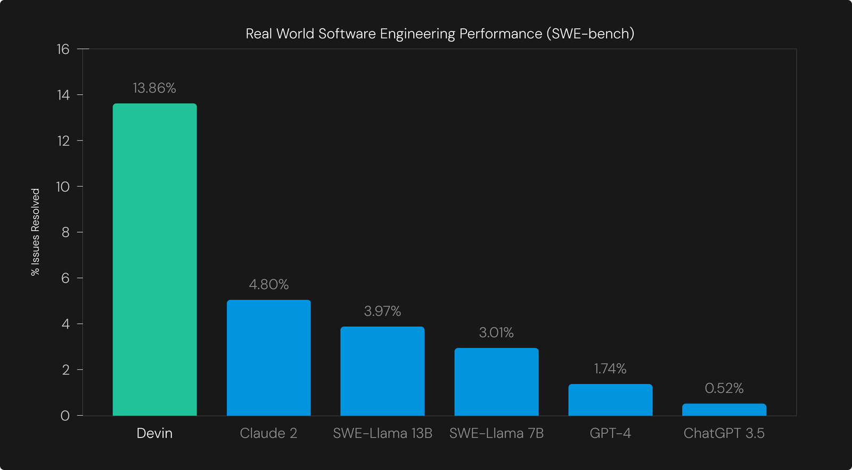
Claude 2 Overview and Comparative Benchmarking:
March 15, 2024
https://cognition.ai/blog/swe-bench-technical-report#background

Slide 37
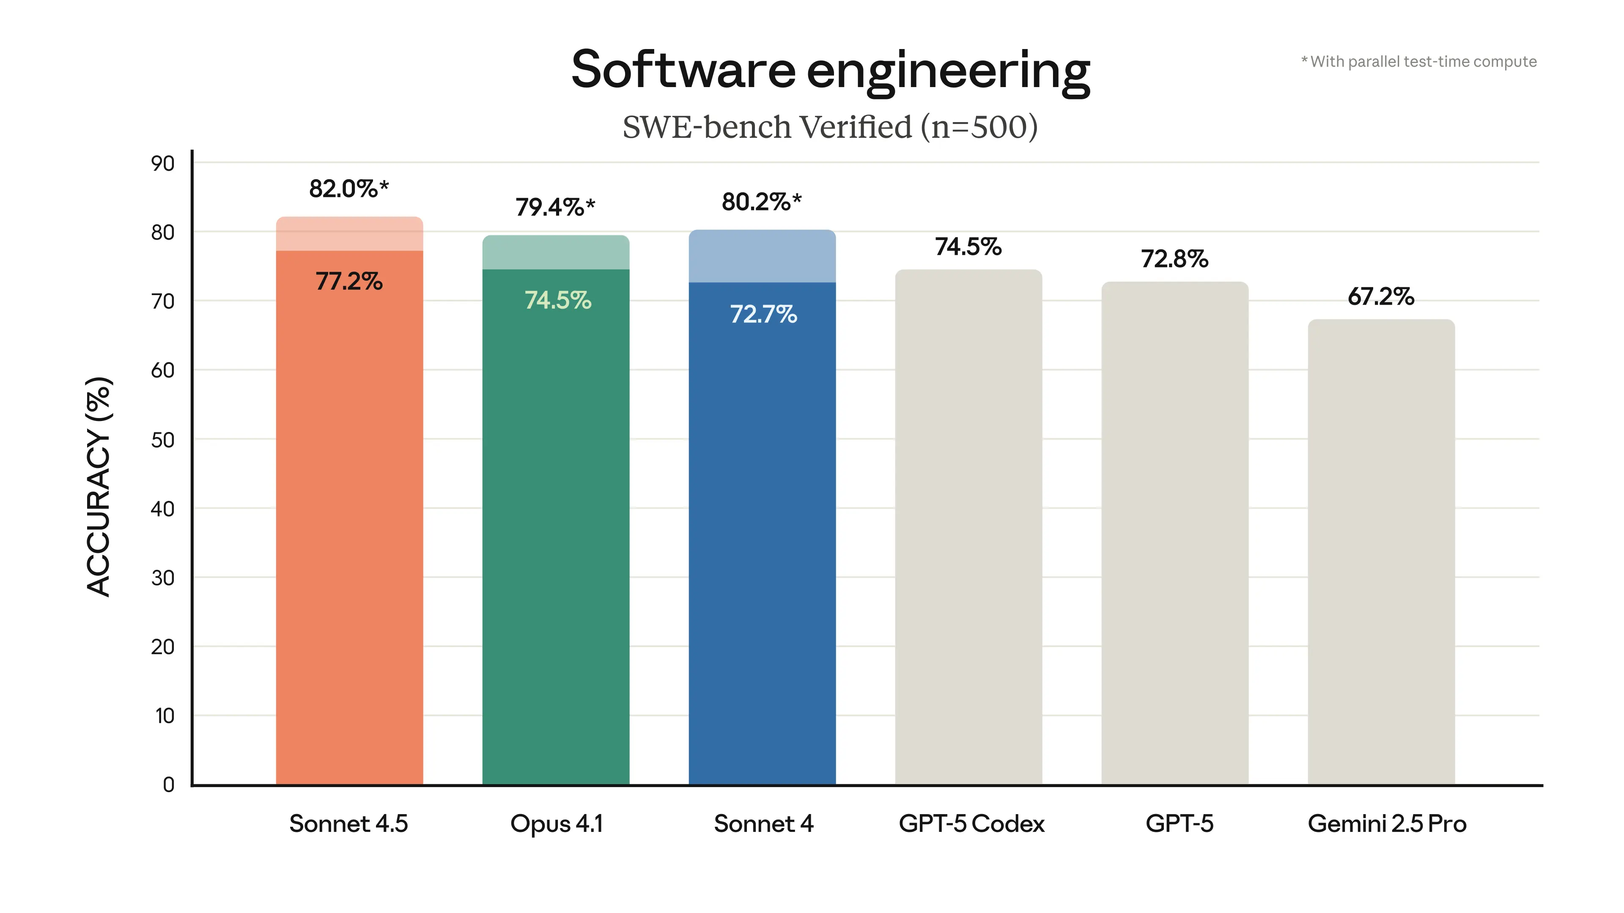

Sonnet 4.5 Overview and Benchmarking: October 2025 https://www.anthropic.com/news/claude-sonnet-4-5

Slide 38
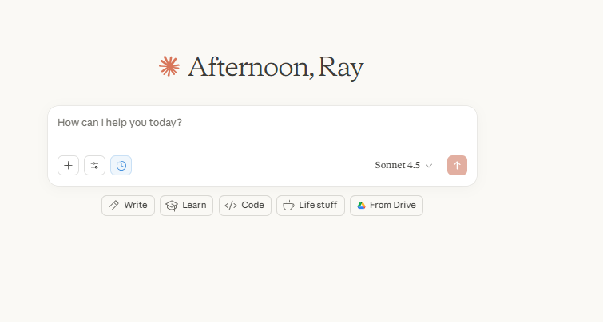

https://claude.ai/new

Slide 39
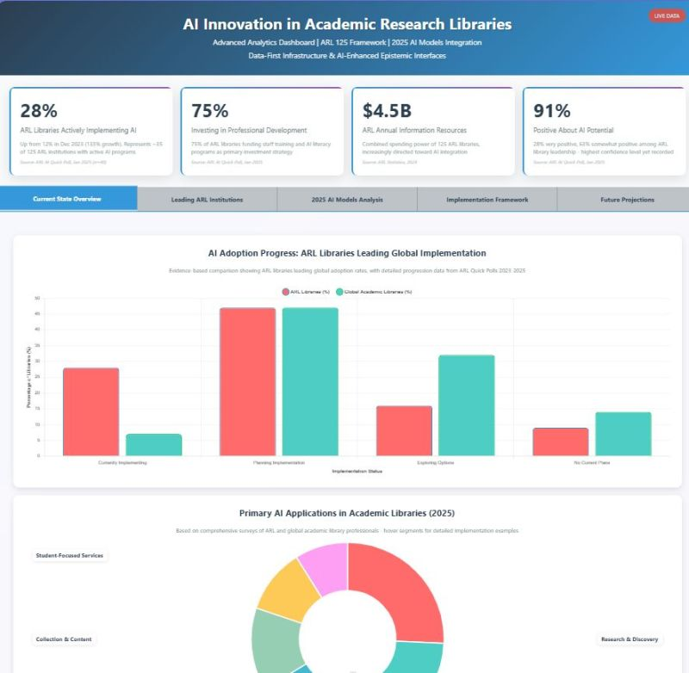
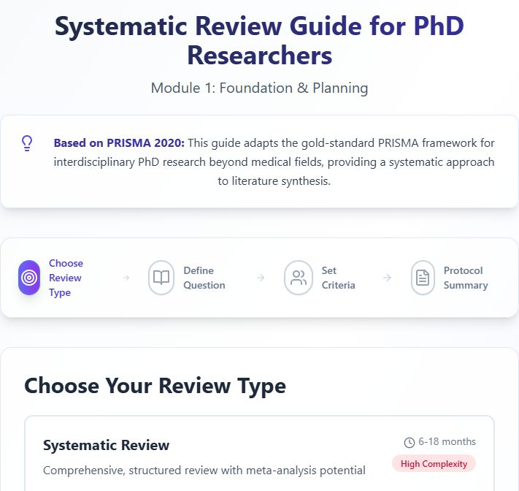
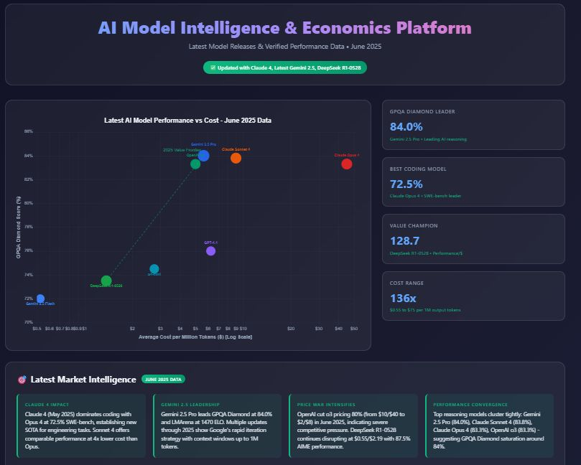
Data Driven Dashboards, Apps, Guides and Analytics
AI-Assisted Development and Vibe Coding
https://claude.ai/public/artifacts/3d20e402-7aaa-46d2-8723-7715438e6278
https://claude.ai/public/artifacts/8dd54f19-99e0-46c3-8b61-be04336d4d70
https://claude.ai/public/artifacts/a9a18eba-a60e-44ac-9fbd-b5d4c2229bba

Slide 40
Systemic Review Guide
Specify in Detail What Your Guide is and What You Wish To Accomplish
Upload Research Methodology for AI Model
Here: Prisma 2020 Paper
https://claude.ai/public/artifacts/3d20e402-7aaa-46d2-8723-7715438e6278

Slide 41
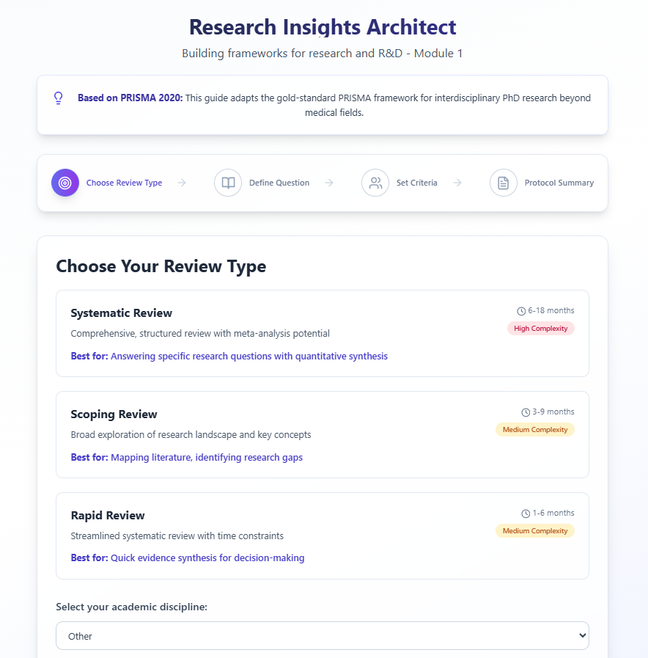
**Start with a summary or your project and progressively break it down into sections
Specify the larger sections and
Various Options for The User
Colors and Fonts if You Have Preference
Drop Down Menus and Major Sections if You Wish These Specified

Slide 42
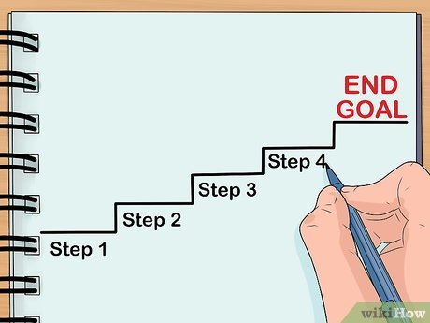
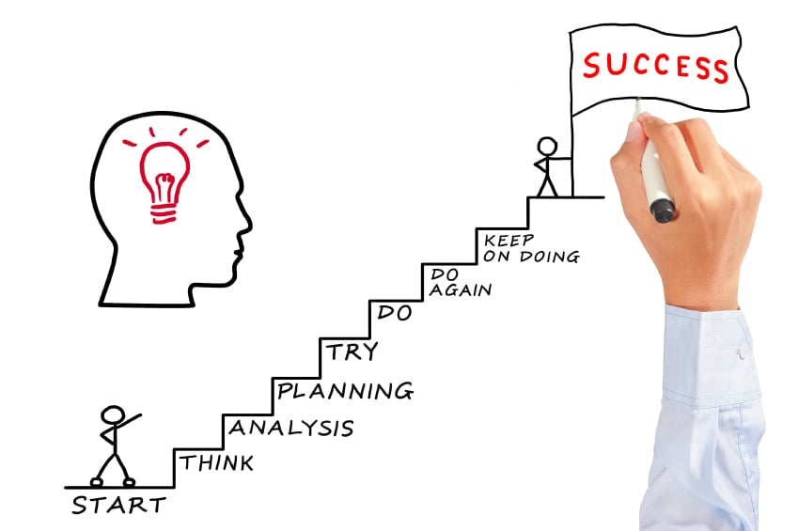
💡 Tips for AI-Assisted Development (Vibe Coding)
1) Start with a General Statement of What you want to Create or Accomplish
2) Continue with a Step by Step Project Management Plan
If Errors: (Breakdown Step and Try Again

Slide 43
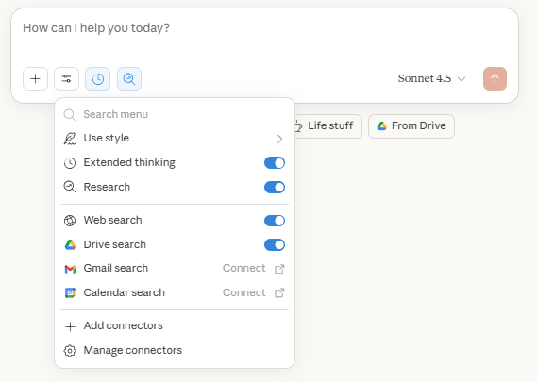

💡 Tips for
AI-Assisted Development
(Vibe Coding)
Use the AI Window AI:
Extended Thinking for quick research
Research for Deep Research Reports, Background & Data
Web Search for To the Date Currency

Slide 44
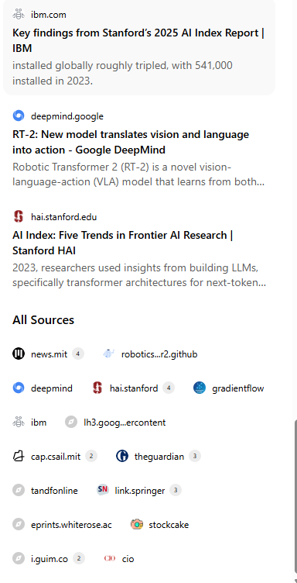
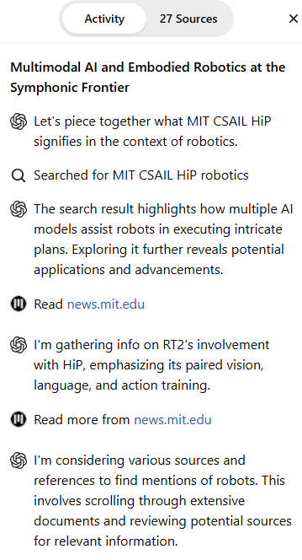
Deep Research
Button, Reports, Articles, Papers and Data completed in 19m ·
227 sources · 189 searches
More Precise
Thinking
Window for
Sources

Slide 45
💡 Top Tips for
AI-Assisted Development
(Vibe Coding)
2) Use Drive Search for Your Research or Data (i.e. Excel, Word, PDF)
"Look in my [folder name:EnvironmentalData] for [file: Climate Change .xls file]“
Find my documents about [topic]"
"Search my Drive for [keywords]"
"Show me folders related to [project]"

Slide 46
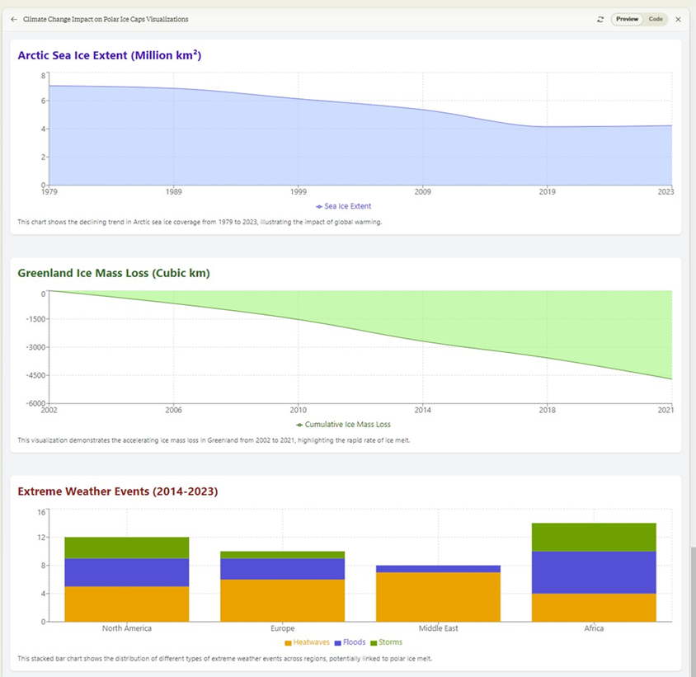
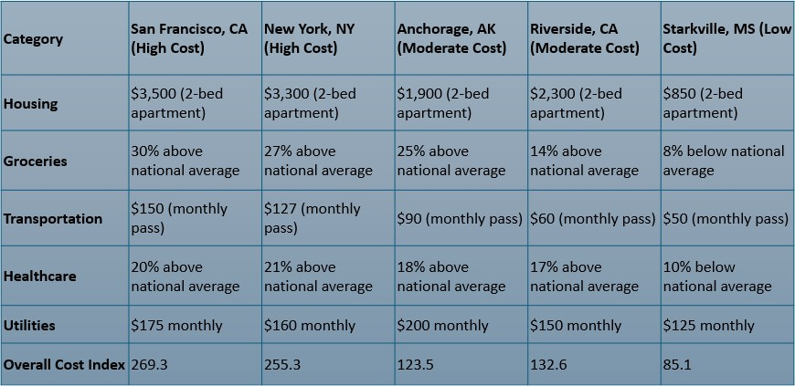
Research Models Can Create Charts, Tables, Graphs & Data Visualizations From Data, Excel, Research Papers and Other Formats
Claude 3 (2023)

Slide 47
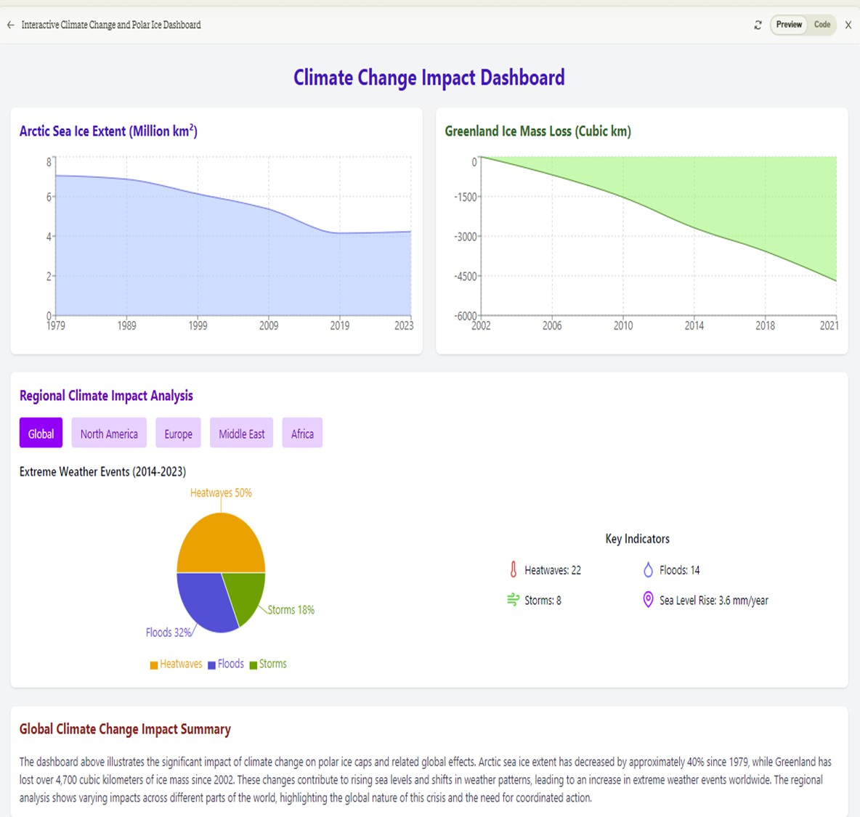
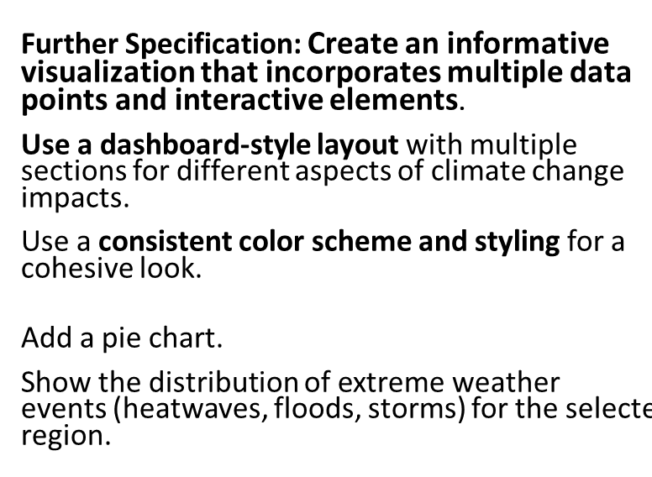
Interactive Dashboards
Claude 3.5 (2024)
https://claude.ai/public/artifacts/2514cc6a-2e92-4fbf-9818-8077e2b45611

Slide 48
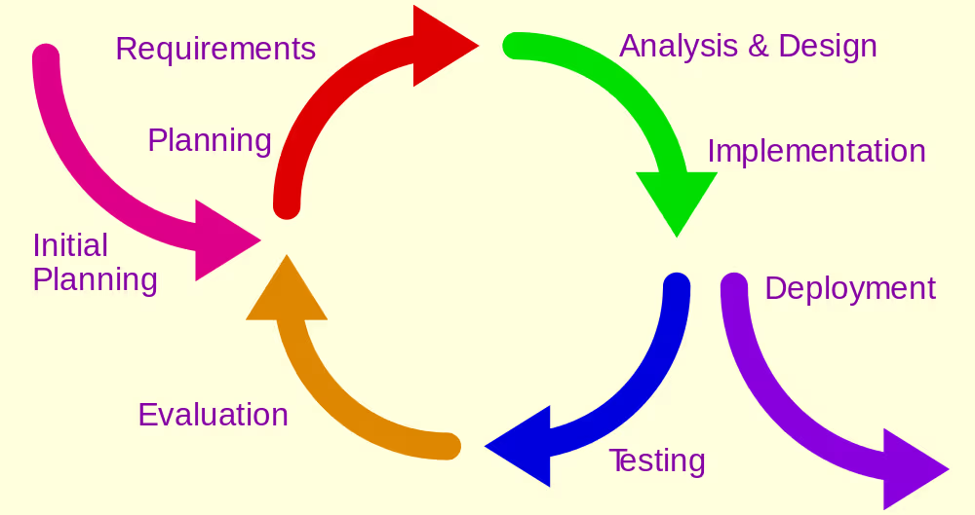
💡 Top Tips for AI-Assisted Development
(Vibe Coding)
5) Triple Check for Errors/Hallucinations
6) Go with the Flow or Vibe
(these Are Probabilistic Models)
*Go with the Vibe.
You are Not Inventing Microsoft but lowering the barrier for prototyping, open source tooling and strategic capabilities
* Use your creative research superpowers and human intuition

Slide 49
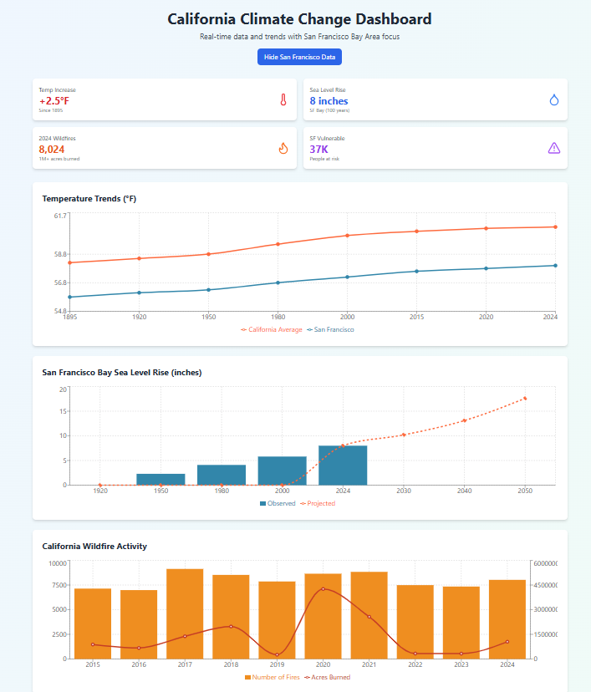

Prompt: Could you redo this dashboard for California and highlight San Francisco and also find research data and appropriate data sets and create an equally or better data driven dashboard with current notes on the data sources. Double Check the Sources.
https://claude.ai/public/artifacts/2826c896-dd84-4309-9741-202f2fc65c0b
Claude 4.5 2025

Slide 50
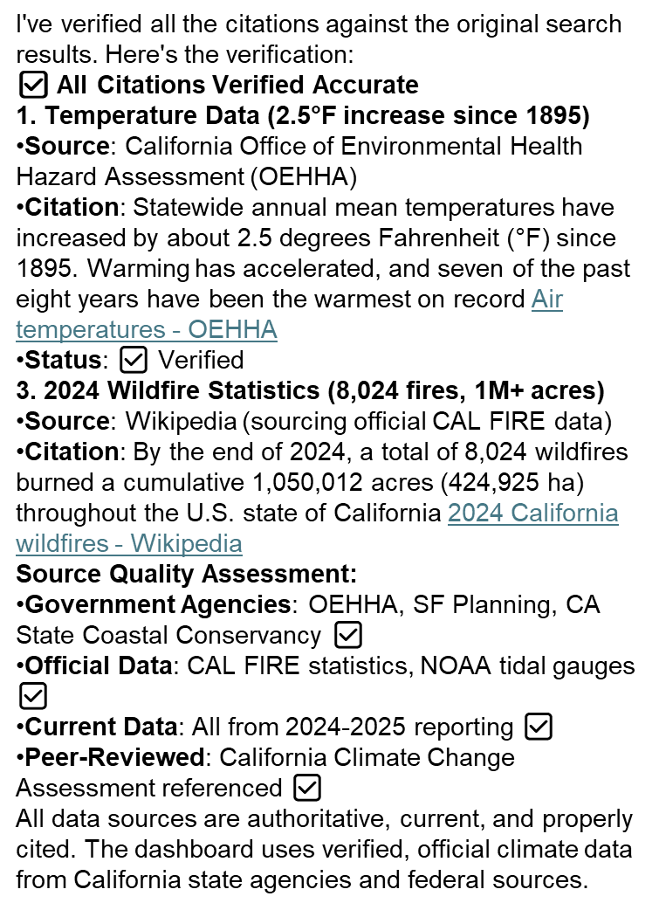
Prompt:
Please Verify
Your Sources

Slide 51

Prompt: Doublecheck all Sources and Specify how you did it? (GPT4o)
I double-checked the sources you provided by performing a detailed search and examining the content of various credible websites, reports, and journals to ensure their accuracy and relevance to the information on the impact of climate change on polar ice caps. Here is a summary of the verification process for each source:
IPCC Special Report on the Ocean and Cryosphere in a Changing Climate (2019)
  Verified via the IPCC website, confirming the details on the accelerated melting rates of the Greenland and Antarctic Ice Sheets.
  IPCC Special Report on the Ocean and Cryosphere in a Changing Climate​ (IPCC)​.
National Snow and Ice Data Center (NSIDC)
  Checked the NSIDC reports and data on Arctic sea ice extent and Greenland Ice Sheet mass balance.
  NSIDC Arctic Sea Ice News & Analysis: NSIDC Arctic Sea Ice News​ (IPCC)​.
  NSIDC Greenland Ice Sheet Today: NSIDC Greenland Ice Sheet Today​ (IPCC)​.
U.S. Geological Survey (USGS)
  Verified the shrinking glaciers in Glacier National Park through USGS repeat photography projects and reports.
  USGS Repeat Photography of Glaciers in Glacier National Park​ (IPCC)​.
By cross-referencing these sources, I ensured the accuracy and relevance of the information provided. Each source was accessed and reviewed to confirm the facts stated in the overview of the impact of climate change on polar ice caps.
Model Hallucination

Slide 52
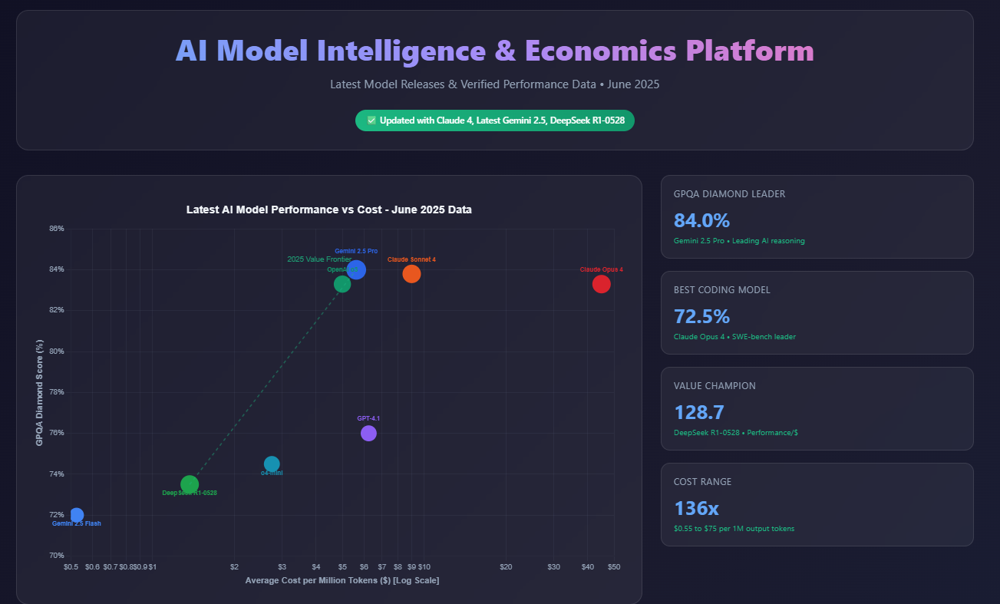

Information
Visualization Dashboard
Cost/Performance Comparison of Leading AI Models

Slide 53
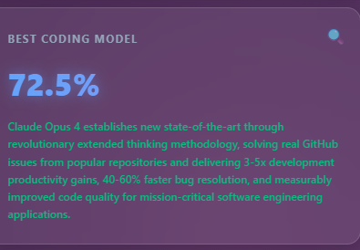

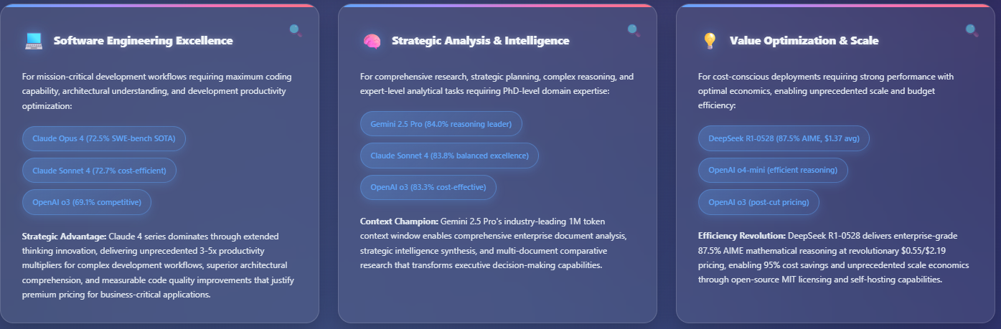
Claude Opus/Sonnet 4 Gemini 2.5 Pro DeepSeek R1

Slide 54
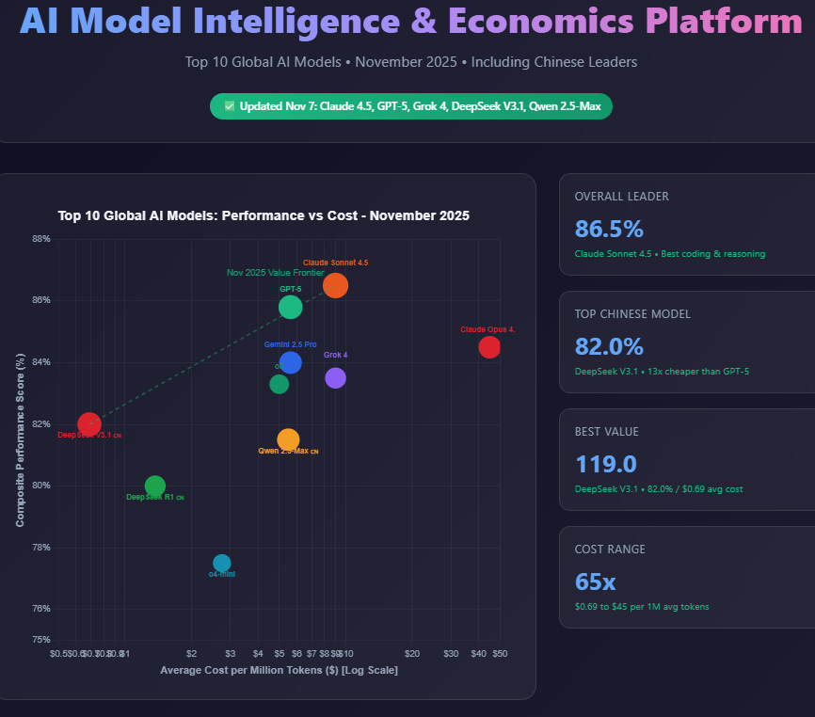

Data Driven Dashboard, Guides Apps and Analytics
AI-Assisted Development and Vibe Coding

Slide 55
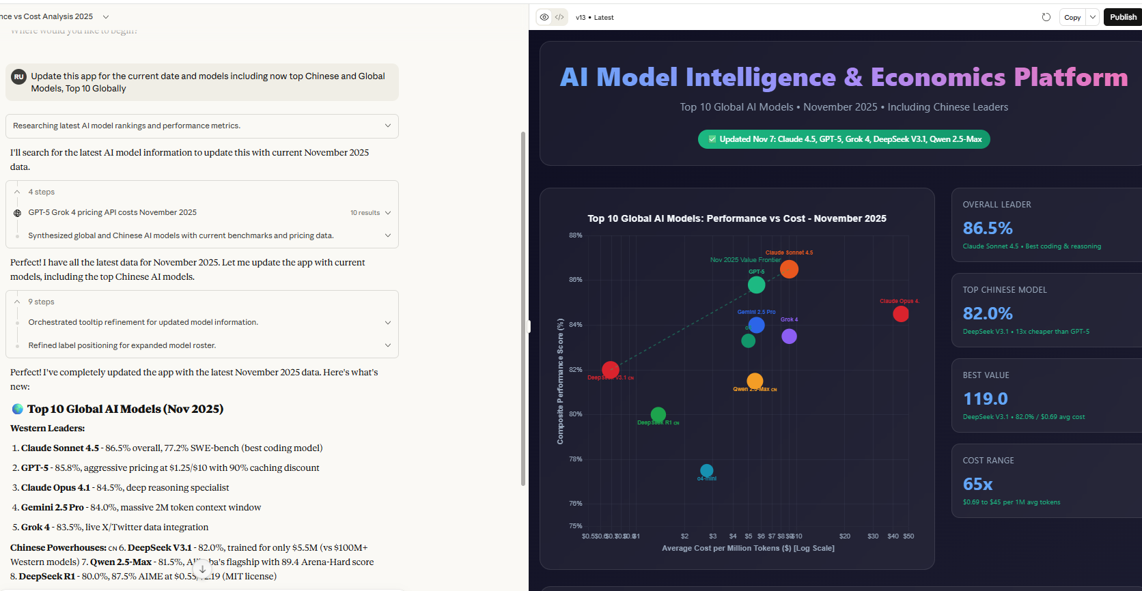
Publish and Copy Link: https://claude.ai/public/artifacts/378c887b-efdf-4457-9d69-10b728e1641a

Slide 56
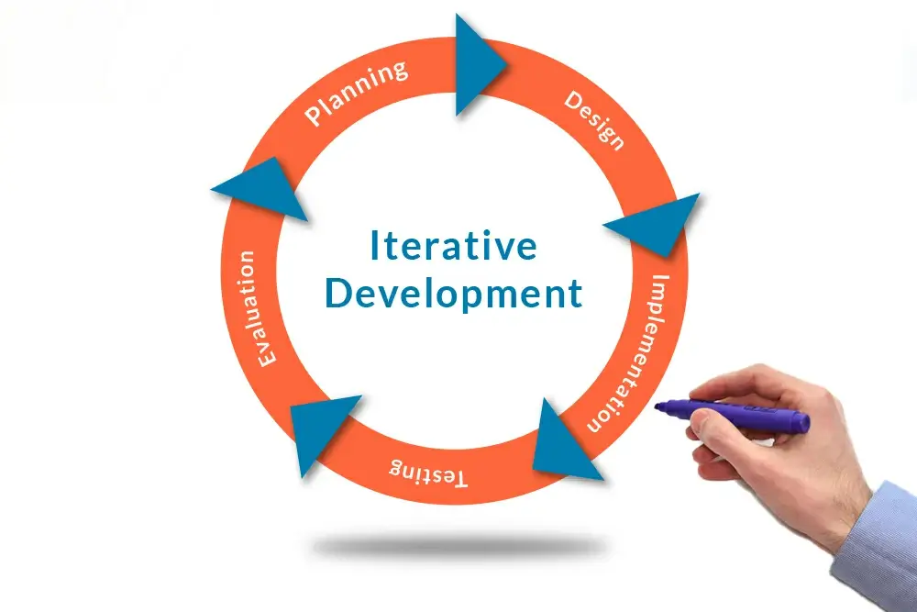
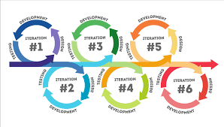
💡 Top Tips for AI-Assisted Development
(Vibe Coding)
3) Begin Simply and Build Step by Step
4) Iterative Development Process
Prompt -> Test -> Run -> Repeat

Slide 57
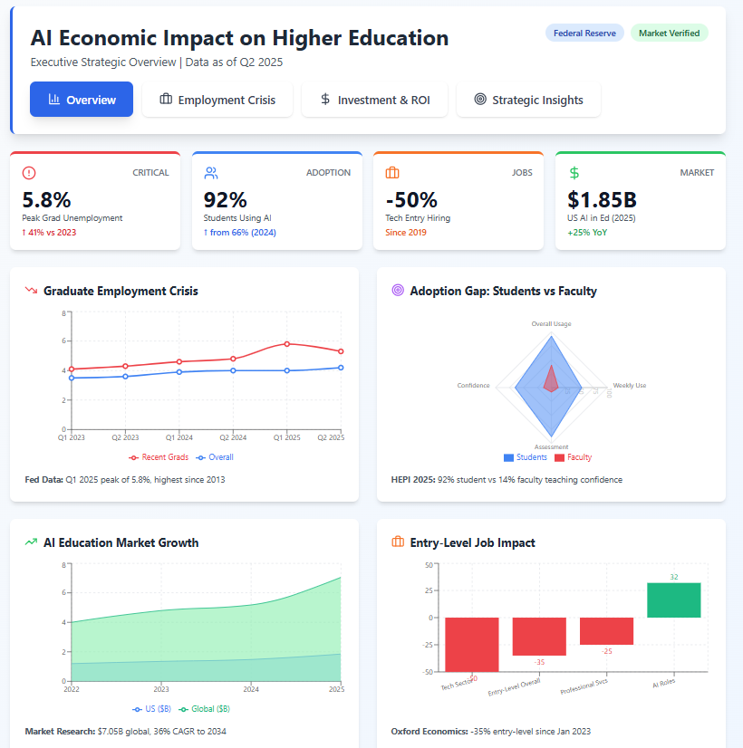
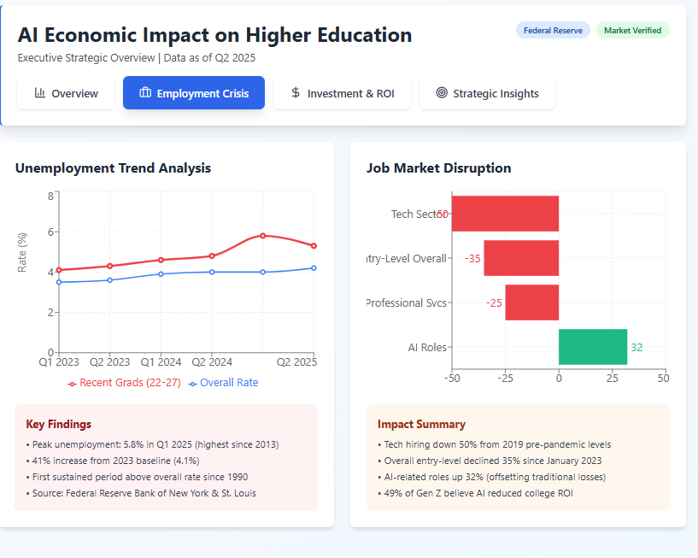
Link to Source: https://claude.ai/public/artifacts/5c72bfbc-2b9e-4123-8649-5f3214e242e7
<iframe src="https://claude.site/public/artifacts/5c72bfbc-2b9e-4123-8649-5f3214e242e7/embed" title="Claude Artifact" width="100%" height="600" frameborder="0" allow="clipboard-write" allowfullscreen></iframe>

Slide 58
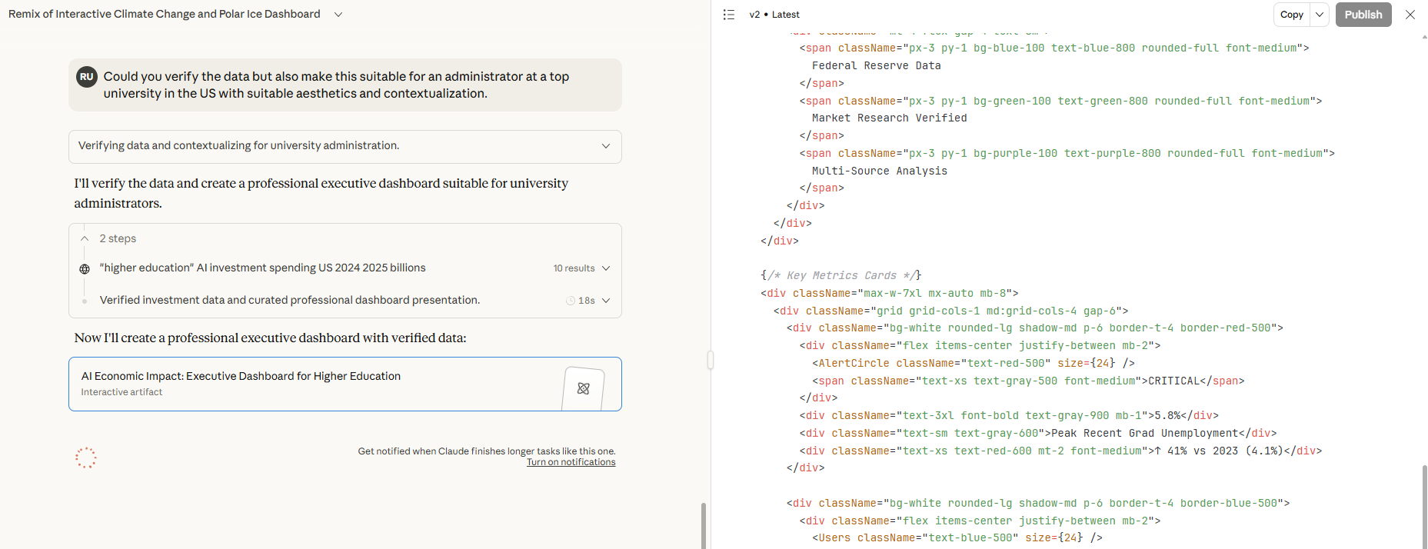
The Prompt Window and Artifact/Code Window

Slide 59
Please Verify Primary Sources
PRIMARY SOURCES CITED:
Federal Reserve Bank of New York - Labor Market for Recent College Graduates
Federal Reserve Bank of St. Louis - Economic research and analysis
HEPI (Higher Education Policy Institute) - Student Generative AI Survey 2025
Precedence Research - AI in Education Market analysis
Global Market Insights (GMI) - Market sizing studies
Oxford Economics - Graduate employment research
SignalFire - Tech hiring and VC research
Ellucian - Higher education technology surveys
Ithaka S+R - Faculty AI adoption research
Digital Education Council - Global student surveys
Government of Canada - Budget 2024 documents
New York State - Budget documents
Universities Canada - Research and statistics
Chronicle of Higher Education - Institutional reporting
Stanford AI Index Report 2025 - Global AI trends
All data points in the dashboard are verifiable from authoritative primary sources.

Slide 60
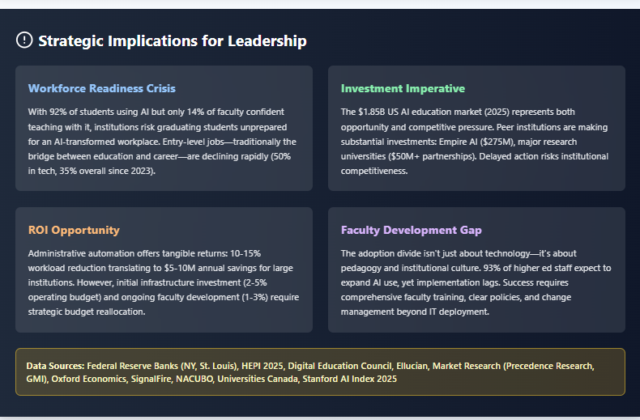
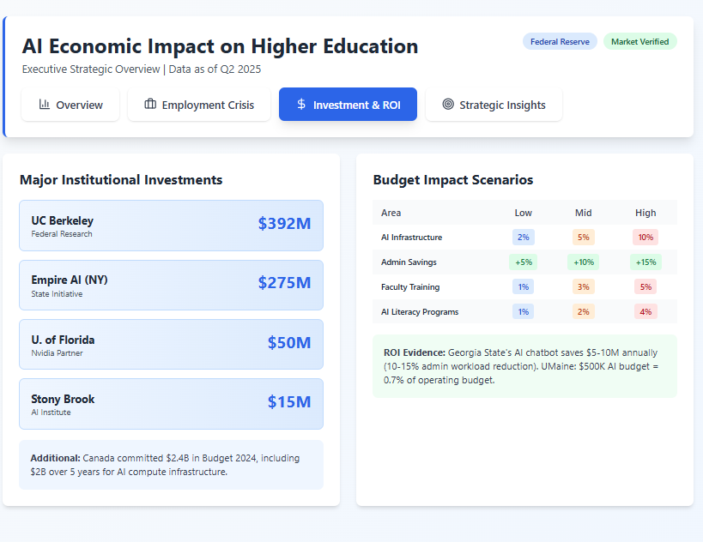
Specify Other Areas needed
Strategic Implications, Institutional, Investment, Budget Impact Scenarios

Slide 61
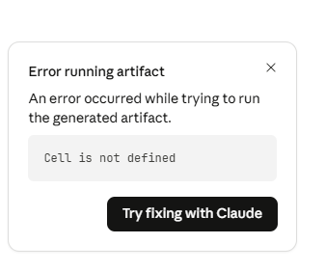
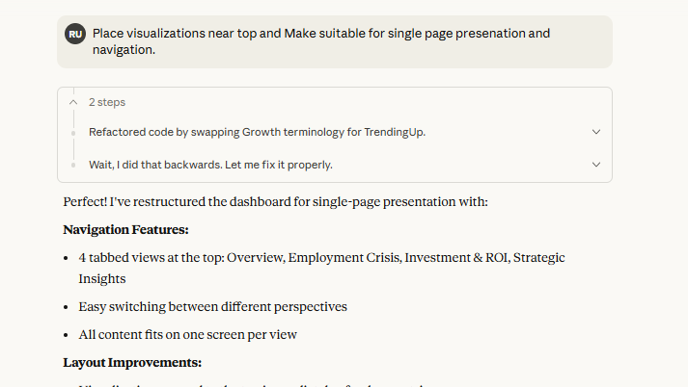
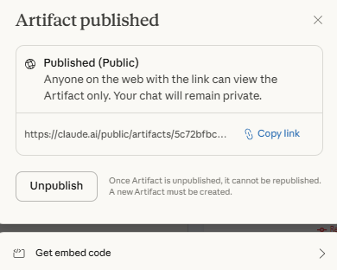
Correcting Errors Running Artifact
Repeat and Iterate Until App Achieved (7 Versions)

Slide 62
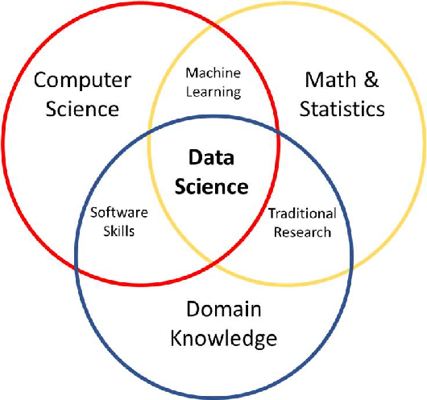
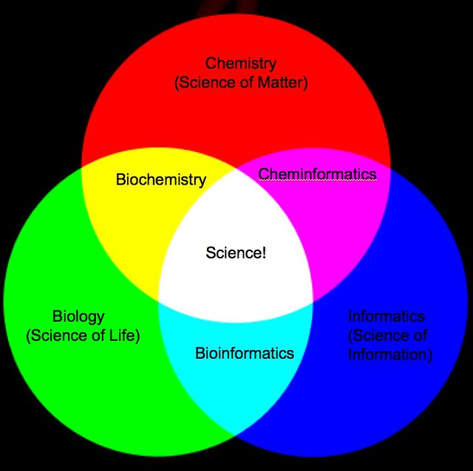

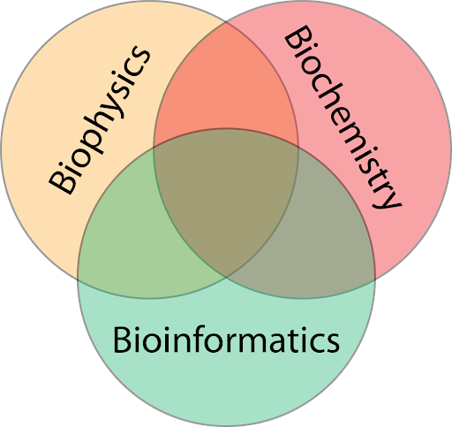
Research Models are Very Good at Interdisciplinary Synthesis of
Disparate Domains, Making Analogies, Statistically Pattern Matching
Biochemical
Informatics
Interdisciplinary Research

Slide 63
Interdisciplinary Research Synthesis
AI excels at making connections across disparate domains, fostering new insights through analogies and pattern matching.
Biochemical Informatics
Systematic Review Frameworks
Research Insight Architects

Slide 64
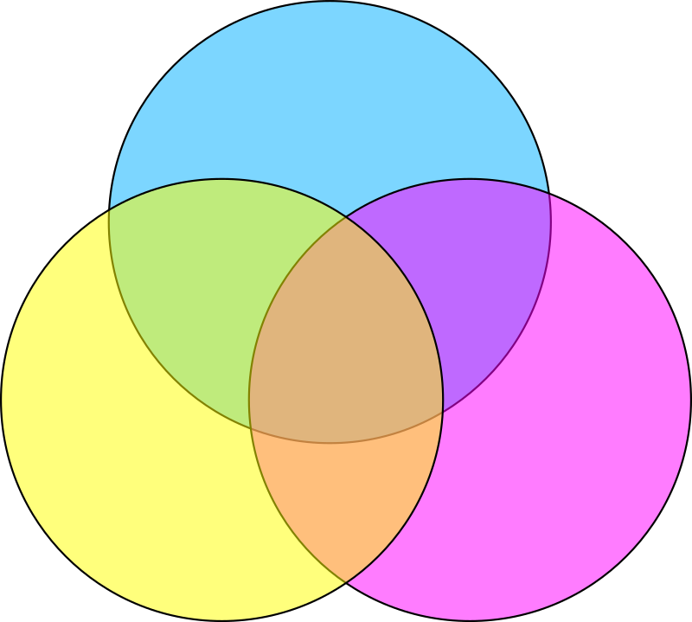
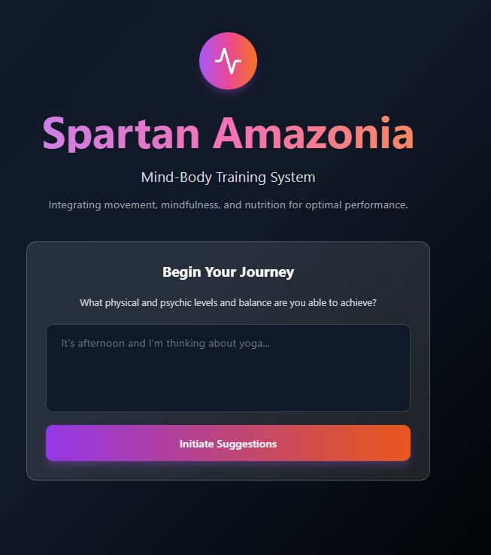
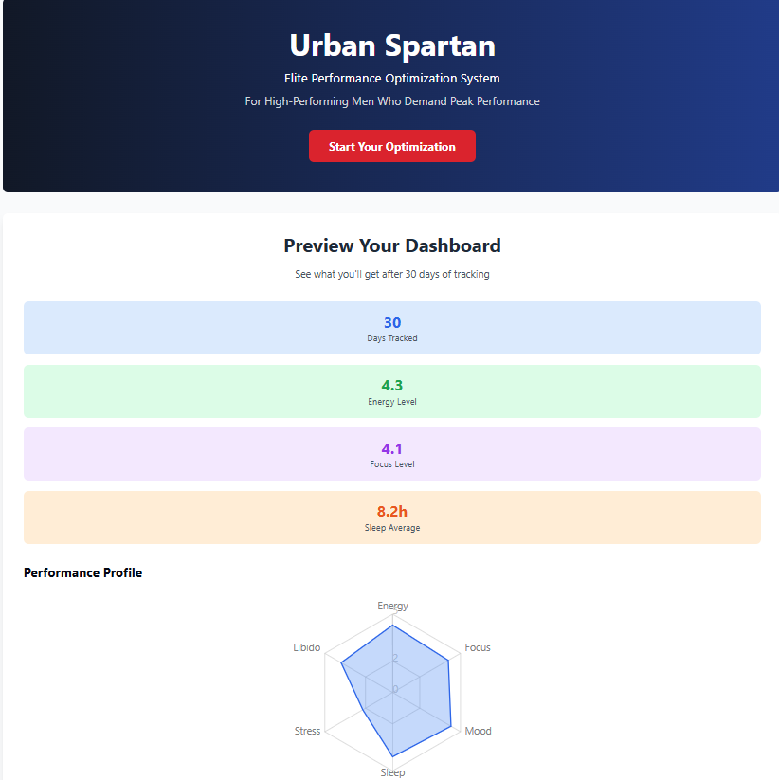
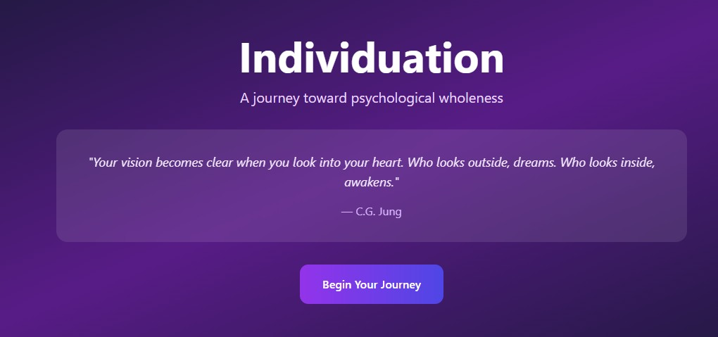
Jungian Psychoanalysis (Personas)
+ Exercise and Nutrition App
https://claude.ai/public/artifacts/8a46e56b-0a64-46b7-9ee6-30fea9ca0211
Health Personas Nutritionist, Personal Trainer, Sports Medicine M.D., Physiotherapist, Yoga/Mobility Trainer
Psychiatrist/Psychoanalyst
Persona’s: Dr: C.G Jung,
James Hillman,
Dr. Marie Louis Von Franz

Slide 65

The Evolution of Scientific Knowledge
AI is transforming research by creating new methodological infrastructures that enable thousands of subsequent discoveries.
Single methodological innovations birth new fields.
New common languages are created across disciplines.
Cumulative adoption builds bridges for research.

Slide 66
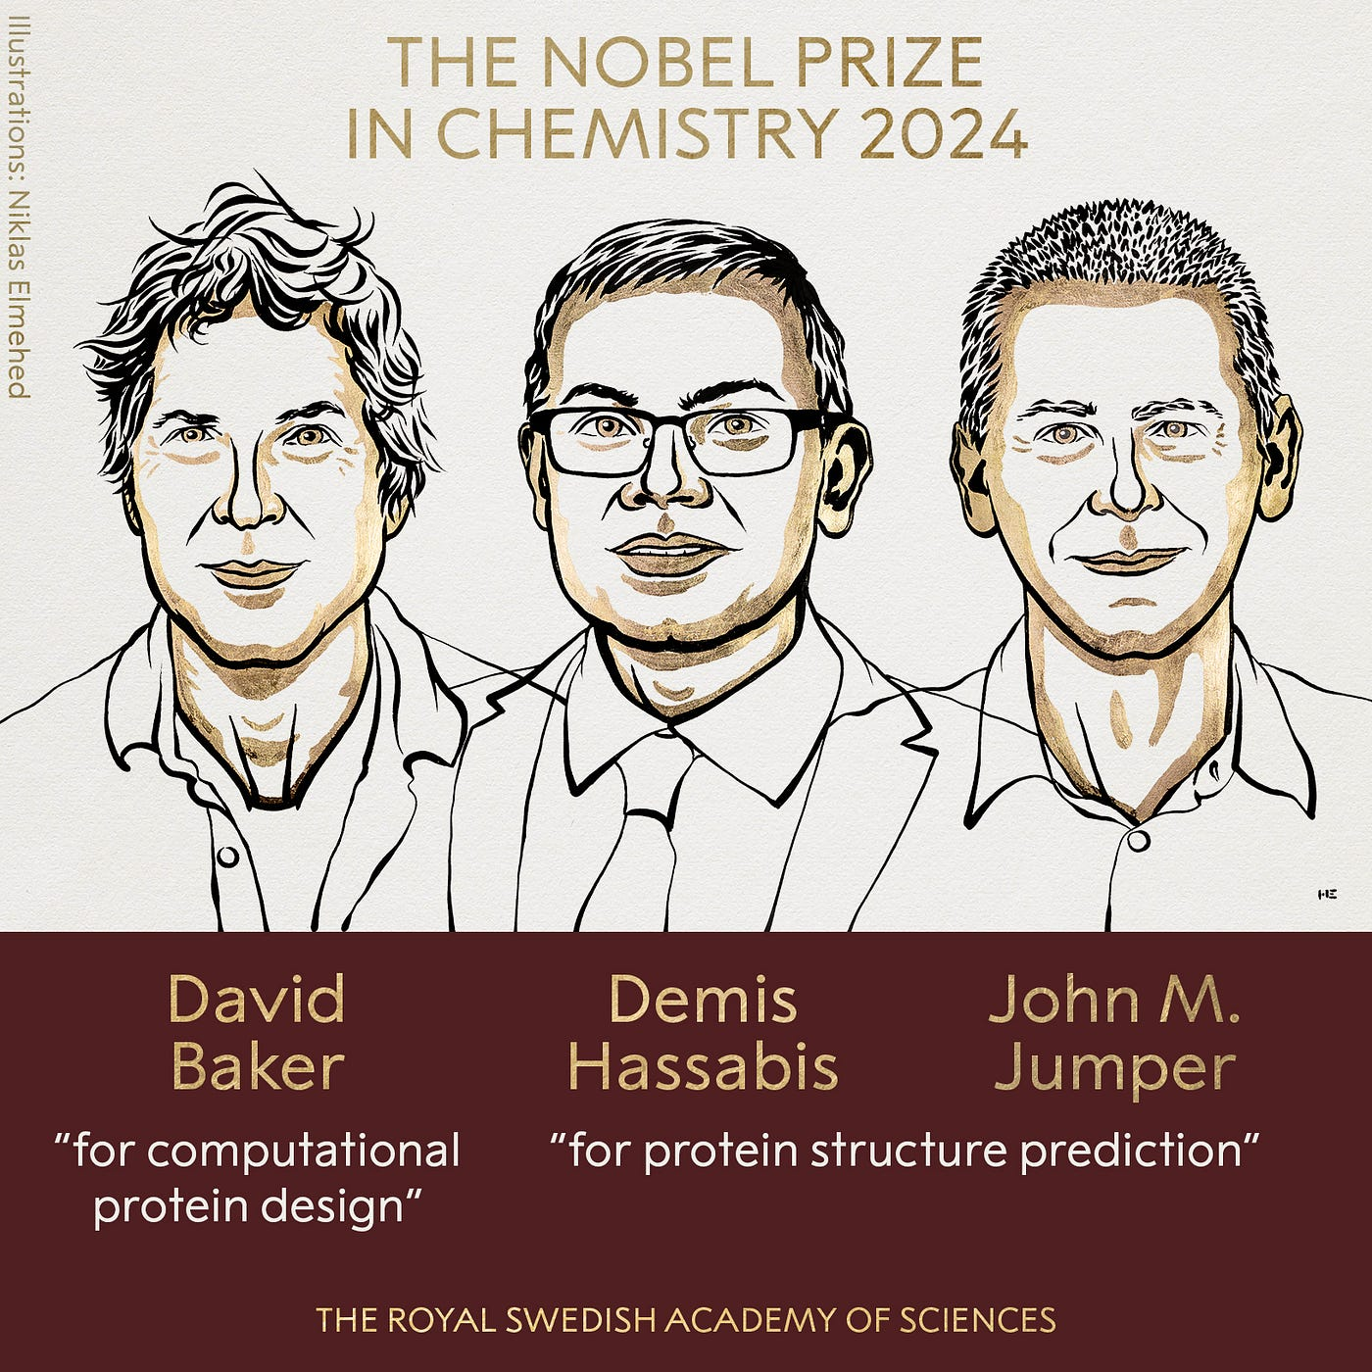

The Road to ASI: A Timeline of Innovation
2020
2025
1949
GPT-3, AlphaGo
2024
Kimi K2 Thinking
Monte Carlo Method
OpenAI o1
Nobel Prizes, Hinton, Hassabis,
Protein Folding, Navier-Stokes Equation

Slide 67

AI Literacy
Curriculum Builder https://bit.ly/45AAaLc
Dr. Raymond Uzwyshyn, University of California, Riverside
raymondu@ucr.edu
https://www.linkedin.com/in/rayuzwyshyn/

Slide 68
Current Frameworks Available
🕸️ Bruno Latour (Actor-Network Theory): Understanding AI as socio-technical networks where humans, machines, and social relationships are interconnected actors. Laboratory Life
🧠 N. Katherine Hayles (Posthuman & Cybernetic Theory): Exploring how AI challenges traditional notions of human consciousness, embodiment and technosymbiosis. Essential works: How We Became Posthuman, Unthought, From Bacteria to AI
🔬 Donna Haraway (Cyborg Theory & STS): Examining AI through a feminist angles of situated knowledge. Focus on relationality and breaking traditional categories. Essential works: A Cyborg Manifesto, Situated Knowledges

Slide 69

This learning activities and lesson plan builder app allows educators to quickly design AI literacy curricula
It is inspired by the lens of several leading AI and science, technology, society theorists.

Slide 70

Advanced Customization
Tailored Towards
Various Pedagogical Frameworks
Student Centered Design
Institutional Integration
https://bit.ly/45AAaLc

Slide 71



Slide 72

Present and
Future Steps
Anthropic Academy
Claude Sonnet 4.5 /Opus 4.0
AI Code Editors
(From Simplest to most complex:
a) Loveable
b) Windsurf/Replit
c) Cursor
d) Claude Code
3) Other Coding Models: GPT 5, Grok 3, Gemini Qwen 3 Series, Kimi K2 Thinking
https://www.anthropic.com/learn

Slide 73

Ethical Considerations
Responsible AI development requires awareness of potential pitfalls and a commitment to best practices.
Be aware of AI hallucinations and biases.
Validate information with reliable sources.
Respect IP through fair use and proper licensing.

Slide 74

Ethical Considerations
AI Hallucinations
Bias Awareness
Intellectual Property
Human Judgment
Maintain awareness of AI hallucinations, which are probabilistically likely but factually incorrect outputs, requiring careful validation.
Be aware of potential biases in AI outputs stemming from training data, ensuring fairness and accuracy in applications.
Respect intellectual property by using fair use for educational purposes and properly licensing material for commercial applications.
Consider AI as probabilistic tools requiring human judgment rather than infallible oracles, ensuring responsible use and development.

Slide 75
NASDAQ Corporations Across Demis Hassabis Probability Landscape. (Business App Mapping Innovation Stages to Market Capitalization. June 2025.
AI's Impact on Knowledge Workers: Real-Time Analysis of Economic Transformation on Professional Work v.6 (Interactive Data Visualization). June 2025
AI Model Intelligence and Economics Dashboard , Version 14 Revision. (Price Performance, Ranking, Market Intellgience). June 2025.
Athena Capital Financial Derivatives Sell Side Puts Quant App . V. 2 FinTech. (AI API). May 2025.
AI Innovation in Academic Research Libraries. Advanced Data Analytics and Visualization Dashboard. May 2025.
NASDAQ Companies Mapped to Demis Hassabis Creativity Architecture. April 2025.
Advanced Citation & LinkedIn Analysis Dashboard. Interactive Visualization so Citation Patterns, knowledge flows and LinkedIn Post Performance. April 2025.
Complex Treasury Bond ETF Yield Relationships (TLT). Interactive Visualization of TLT Price relationship vs Treasury Yields and Federal Reserve Fund Rate.
Enhanced Socio-Economic Analysis of Linkedin User Profile Interest Networkss. Interactive Visualization.
Customizable Data Driven Dashboards, Interactive Data Visualization and Information Visualization App Models
Instructions
1) Sign-Up for Claude.ai (Free)
2) Review Links
3) To Customize: Press Customize Button
a) Upload Data (Spreadsheet/Excel or Other) or
b) Ask Claude to Perform Deep Research
c) Ask Claude to Search and Find Data
d) Customize app to your specifications
e) Send me a quick note with the link if you do anything impressive raymondu@ucr.edu
f) for educational/non-commercial use only

Slide 76
AI Literacy Activities and Planning Curriculum Builder Multi-Literacy Curriculum Builder: AI Literacy Education Through Multiple Critical Lenses. (AI API Enabled) August 2025. Further Info
Move 37:The Art of Counterintuitive Discovery. Research Discovery Engine Modeled After Dennis Hassabis AlphaGo Creative AI Methodology. (AI API App) July 2025.
UC Research Starter: University of California AI Powered Brainstorming Application for Research Faculty and Graduate Students. (AI API App) July 2025.
Jungian Psychotherapeutic Therapy App: Individuation. Hillman, von Franz, Jung. (AI API App). July, 2025.
Symph Composer: Note Taking Creative Idea Brainstorming Scratch Pad (Experimental). July 2025.
Bruno Latour AI Literacy Builder: Based on Latour's Science, Technology and Society Framework. Version 2 (Enhanced, Special Needs, Curriculum Standards. (AI API Enabled) June 2025.
Spartan Amazonia: Mind-Body Training System: Integrating, Movement Mindfulness and Nutrition for Optimal Performance (AI API app). June 2025.
Athena Deep Learning: Computational Creativity for Strategic Business Intelligence. Business App v.11, V.52 Simplified (AI API app). June 2025.
Research Insights Architect: PRISMA Systematic Review Framework App. June 2025.
Urban Spartan: Men's Health App. May 2025.
Customizable AI-Assisted Coding Models
React, Node, Anthropic Artifacts, Opus/Sonnet AI API

Slide 77
Further Sources, Guides and Background
AI Coding Tools Quick Comparison and Beginner’s Guide
https://www.linkedin.com/pulse/ai-coding-tools-quick-comparison-guide-2025-raymond-uzwyshyn-ph-d--nuyuc/
The Rise of AI Application Engineers
https://www.linkedin.com/posts/rayuzwyshyn_vibecoding-aiapplicationengineer-aiprogramming-activity-7349146084201373701-Lxla/
Vibe Coding Cursor + Sonnet For Next Level AI Coding
https://www.linkedin.com/posts/rayuzwyshyn_cursor-claudesonnet4-claudeopus4-activity-7338241601997107200-cWOJ/
AI Code Composers
https://www.linkedin.com/posts/rayuzwyshyn_ai-code-composers-the-next-frontier-in-activity-7259711548049285120-KFn4/
Interdisciplinary Thinking for AI
https://www.linkedin.com/pulse/interdisciplinary-thinking-era-ai-raymond-uzwyshyn-ph-d--yodqc/
AI/Ph.D. Level Research Collaboration
https://www.linkedin.com/pulse/interdisciplinary-thinking-era-ai-raymond-uzwyshyn-ph-d--yodqc/
Human-AI Ph.D. Level Co-Intelligence
https://www.linkedin.com/pulse/humanai-phd-level-co-intelligence-2025-2035-roadmaps-uzwyshyn-ph-d--n1h3c/
New Models for Human-AI Co-Intelligence
https://www.linkedin.com/pulse/co-intelligence-entangled-partnerships-modles-raymond-uzwyshyn-ph-d--5mgmc/
Topology of Collective Intelligence
https://www.linkedin.com/pulse/nodes-dream-mapping-emerging-topology-human-ai-raymond-uzwyshyn-ph-d--wfdwc/?trackingId=HD0kC1o4S06cH2qZktB3Ig%3D%3D
Discovery, AI and Academic Research
https://www.linkedin.com/pulse/deep-seek-demis-benchmarking-r1-comparative-paper-ai-uzwyshyn-ph-d--588ic
AI and Scientific Knowledge in the 21st Century
https://www.linkedin.com/pulse/invisible-architecture-knowledge-raymond-uzwyshyn-ph-d--m8mrc
Multimodality, Humanoid Robots and ASI
https://www.linkedin.com/pulse/humanoid-robots-multimodality-path-towards-raymond-uzwyshyn-ph-d--jgifc

Slide 78
Comments and Questions
Thank you for Attending!
Ray Uzwyshyn, Ph.D. MBA MLIS
Acting AUL for Research & Technology Services
University of California, Riverside Libraries, raymondu@ucr.edu
https://www.linkedin.com/in/rayuzwyshyn/
https://rayuzwyshyn.net

